Slide 1
Huffman Trees

Slide 2
Huffman Encoding
Huffman Coding is a famous Greedy Algorithm.
It is used for the lossless compression of data.
It uses variable length encoding.
It assigns variable length code to all the characters.
The code length of a character depends on how frequently it occurs in the given text.
The character which occurs most frequently gets the smallest code.
The character which occurs least frequently gets the largest code.
It is also known as Huffman Encoding.

Slide 3
Prefix Rule (Codes)
Huffman Coding implements a rule known as a prefix free (code).
This is to prevent the ambiguities while decoding.
It ensures that the code assigned to any character is not a prefix of the code assigned to any other character.

Slide 4
Steps in Huffman Coding
There are two major steps in Huffman Coding
1. Building a Huffman Tree from the input characters.
2. Assigning code to the characters by traversing the Huffman Tree.

Slide 5
Huffman’s Algorithm
Step1: Initialize n one-node trees and label them with the characters of the alphabet. Record the frequency of each character in its tree’s root to indicate the tree’s weight (frequency).
Step2: Repeat the following step3 until a single tree is obtained.
Step3: Find two trees with the smallest weight. Make them the left (smaller weight) and right subtree (larger weight) of a new tree and record the sum of their weights in the root of the new tree as its weight.

Slide 6
Example Problem
Consider the five-symbol alphabet {A, B, C, D, _} with the following occurrence frequencies in a text made up of these symbols:
0.1, 0.15, 0.2,0.2,0.35
Construct a Huffman tree using the above data
Encode the text DAD_BA using the huffmancode
Decode the text 10011011011101
symbol | A | B | C | D | _
frequency | 0.35 | 0.1 | 0.2 | 0.2 | 0.15

Slide 7

Huffman Tree construction
Step 1: Construct a one node tree according to the ascending order of their frequency

Slide 8

Combine the least frequency value and sum of their values and form a new tree

Slide 9

Recursively do the combining of tree until a single tree is formed

Slide 10
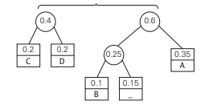

Slide 11
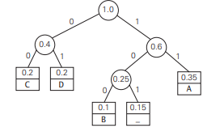
C = 00
D=01
B= 100
_= 101
A =11

Slide 12


Resultant codeword
Encode the text DAD_BA :01110110110011
Decode the text 10011011011101
BAD_AD
= 0.35* 2 + 0.1*3 + 0.2*2+ 0.2*2+ 0.15*3
= 2.25

Slide 13
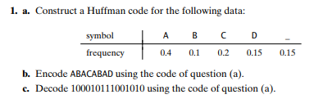
Homework problem

